Slide 1
CULTURE DECK
BE EXCEPTIONAL

Slide 2
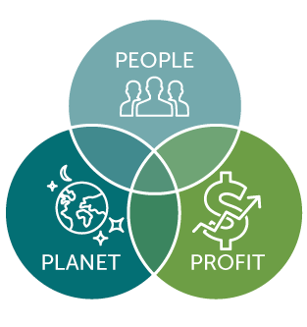
Our Sustainability philosophy: The Tripple Bottom Line
People
At Newmark, we are committed to empowering our team members to become the best possible version of themselves and support them to achieve their life aspirations, not only in their careers but also in society.
Profit
As such, we strive to create value in Society by creating more employment and supporting more clients to become a Force for Good in the community. This is why are committent to business growth and sustainability.
Planet
As Newmark, we try to reduce our ecological footprint as much as possible, while advocating for environmental conservation in our business ecosystem.

Slide 3
Critical Pillars of Our Culture
We believe in mutual investment for mutual benefit
1
Alliance
2
The Team
3 Leadership & Coaching
We inspire one another to greater heights
We exercise Freedom with responsibility

Slide 4
1 - The Alliance
Team members shall endeavour to help transform the company.
In return, managers and the company shall help to improve the team members’ market value and transform your career (preferably within Newmark).
Team members, management and shareholders all have core aspirations and values, and our relationship is a mutual alliance that needs to help all of us. We will act to maintain a long-term alliance, even if the employment relationship ends.
The professional network of all managers and team members is a valuable asset for the individual and the company as a whole.
Lifetime employment is over for most of us. But a valuable relationship should last a lifetime.
If and when you leave the company, if you’re in good standing, we will invite you to our corporate alumni network. As a current employee, feel free to tap the alumni network for help on solving current business challenges.

Slide 5
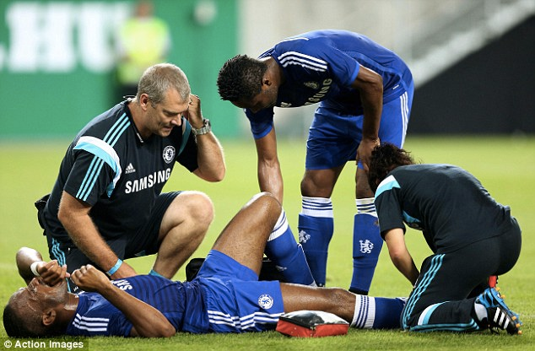
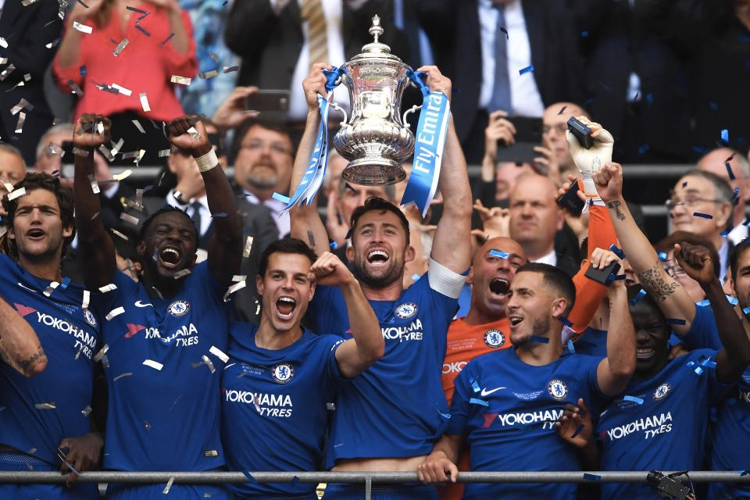
2 - A Team-Centred Structure that fosters freedom & responsibility
Ours is a culture whose sole purpose is to help us achieve nothing else but operational and professional Excellence
Just like a top championship team

Slide 6
We believe that what makes a workplace great is Great Colleagues! This is why we strive to hire well and we help each other to be great. We also keep improving our culture as we grow, and we strive to enhance our ability to have a better bigger positive impact in the world through our craft.

Slide 7
Seven Aspects of our Culture
Core Values
Values are what we Value
High Performance
Freedom & Responsibility
Context, not Control
Growth & Development
Leadership & Coaching
Integrity
Love (Self, team, client, Society)
Courage
Lifelong learning
Operational Excellence
Trust

Slide 8
Behaviors and skills that we value
Communication
You listen well, You are articulate and concise. You treat people with respect independent of their status.
Impact
You demonstrate consistently strong performance so colleagues can rely upon you
Curiosity
You seek to understand our strategy and market,and are broadly knowledgeable beyond your field
Innovation
You re-conceptualize issues to discover simple and practical solutions to hard problems
Courage
You say what you think even if it is controversial and make tough decisions when necessary
Honesty
You are non-political when you disagree with others and only say about your colleagues what you would say in front of them

Slide 9
Loyalty is Good
Our High Performance Culture may not be right for everyone
Loyalty is good as a stabilizer
People who have been stars for us, and hit a bad patch, get a near term pass because we think they are likely to become stars for us again
We want the same: if Newmark hits a temporary
bad patch, we want people to stick with us
But unlimited loyalty to a shrinking firm, or to an ineffective employee, is not what we are about
Many people love our culture, and stay a long time
They thrive on excellence and candor and change
They would be disappointed if given a severance package, but lots of mutual warmth and respect
Some people, however, value job security and stability over performance, and don’t like our culture
They feel fearful at Newmark
They are sometimes bitter if let go, and feel that we are a political place to work
We’re getting better at attracting only the former, and helping the latter realize we are not right for them

Slide 10
The Rare Responsible Person
Responsible People
Thrive on Freedom, and are Worthy of Freedom
Self motivating
Self aware
Self disciplined
Self improving
Acts like a leader
Doesn’t wait to be told what to do
Picks up the trash lying on the floor

Slide 11
Good Processes can help to expand Freedom
Is Freedom Absolute?
Freedom is not absolute, and it also entails acting in Newmark’s best interest
Like “free speech” there are some limited exceptions to “freedom at work”, particularly in regards to confidentiality, legal and ethical issues. Dishonesty, harassment are intolerable
“Good” process helps talented people get more done
Letting others know when you are updating code
Spend within budget each quarter so don’t have to coordinate every spending decision across departments
Regularly scheduled strategy and context meetings

Slide 12
The best managers figure out how to get great outcomes by setting the appropriate context
Good Context
Link to company/functional goals
Relative priority (how important/how time sensitive)
Critical (needs to happen now), or…
Nice to have (when you can get to it)
Level of precision & refinement
No errors (credit cards handling, etc…), or…
Pretty good / can correct errors (website), or…
Rough (experimental)
Key stakeholders
Key metrics / definition of success

Slide 13
Three Necessary Conditions for Promotion
Job has to be big enough
We might have an incredible manager of something, but we don’t need a director of it because job isn’t big enough
If the incredible manager left, we would replace with a manager, not with a director
Person has to be a superstar in current role
Could get the next level job here if applying from outside and we knew their talents well
Could get the next level job at peer firm that knew their talents well
Person is an extraordinary role model of our culture and values
‹#›

Slide 14
3 - Leadership & Coaching that optimize high performance
Leadership is about service to something bigger than self, and seeks to maximize the potential and collective ability of the team
Although team leaders have an added responsibility of setting the vision, we believe that everyone is a coach and a coachee, as we believe in everyone inherent ability to bring value and knowledge into the team
We coach the coachable, and believe that servant leadership is the best of them all
The most important currency in a relationship is trust, and it happens alongside other elements such as loyalty, integrity, ability, keeping promises and mutual exchange of value. It is the first thing to create when building a relationship
Psychological safety is key: The team is safe for interpersonal risk-taking
We listen to understand, not to respond. Active listeners make great leaders
We tell the truth, even when it is difficult to do so, because we care.
We bring our full selves to work In case of a problem, we rally the team first, then tack the issue

Slide 15
This is our Culture

